Slide 1







Instructions: You will hear a male and a female talker. Please select if the female talker says a word or a nonword.
Filler Trial
Critical Trial
logelai
romantic
publi sh er
dino s aur
Talker A
Talker B
Talker A
Talker B
Left
Right
Sh
S
Participant
Left
Participant
Right
Participant

Slide 2
Critical Trial
publi sh er
dino s aur
Talker A
Talker B
Sh
S
Instructions: You will hear a male and a female talker. Please select if the female talker says a word or a nonword.
Left
Participant
Right
Participant
Filler Trial
logelai
romantic
Talker A
Talker B
N
W
Left
Participant
Right

Slide 3
Talker A
Talker B
Talker B
Talker A
Sh
S
Sh
S
Left
Right
Left
Right
Sh
S
Sh
S
Left
Right
Left
Right
Left
Talker A
Talker B
Talker B
Talker A
S
Sh
S
Sh
Left
Right
Left
Right
S
Sh
S
Sh
Left
Right
Left
Right

Slide 4
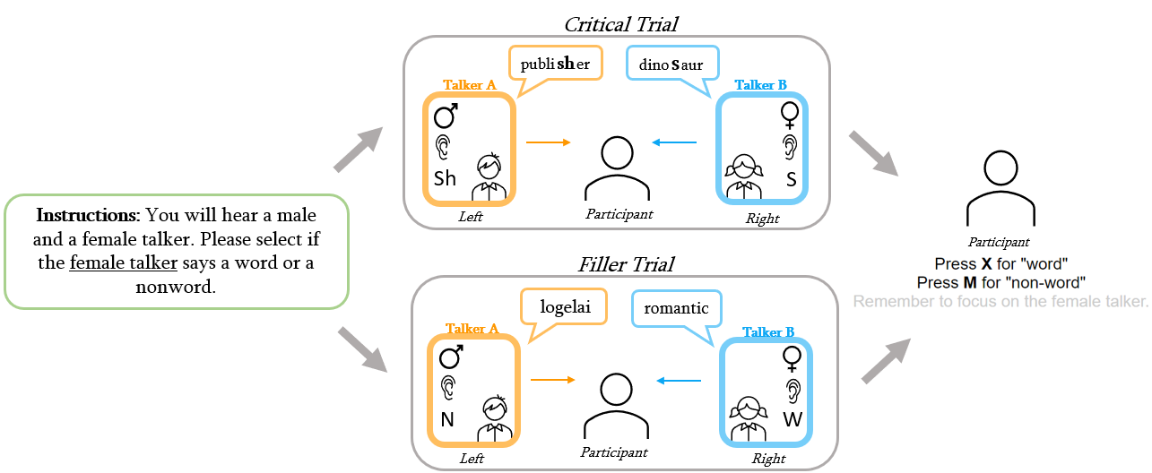
Figure 5
Figure 5: A visual diagram of a single trial. Participants will be instructed to attend to either the male or female talker at the beginning of the experiment (left, green box). Each subsequent exposure trial will feature two talkers, either in a critical trial (top) where both talkers produce a word that contains a s/sh sound, or a filler trial (bottom) where one talker produces a word and the other a nonword. The participant must then select if the Attended Talker produced a word or a nonword for each exposure trial (right).

Slide 5
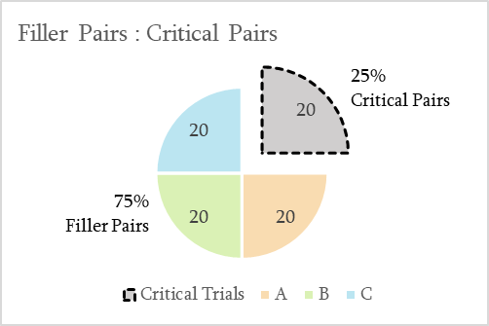
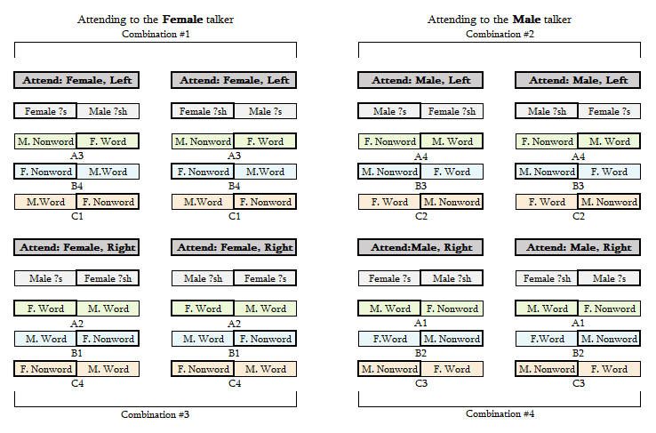
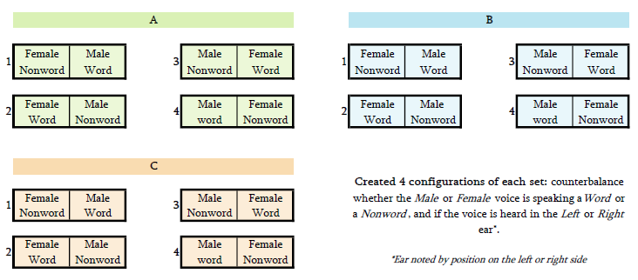
Figure 4c
Figure 4b
Figure 4c: The break
Figure 5
Figure 4a
Figure 4b: The Set Version assigned to each Critical Item combination. The 20 Critical Items in each experiment are shown in gray, Set A in green, Set B in blue, and Set C in orange. The letter number combo below each pair (e.g., A3 below Set A in Combination #1 above) correlates to the Set and Version in Figure 4a. The ear the talker is presented in correlates to the position of the word in the pair (e.g., in Combination #1 above, the Female talker is presented in the Left Ear), and outline around the Attended Talker is bolded.
Figure 4a: The 60 Filler Items (60 unique Word/Nonword pairs) used in this experiment were divided into 3 Sets (A, B, C) of 20 Filler Items. We created 4 Versions of each Set (1, 2, 3, 4) to produce every combination of factors—i.e., if the Male or Female voice speaking a Word or a Nonword, and if the voice is heard in the Left or Right Ear. The Version is noted by the number to the left of the set pair. The Ear presentation is represented by the horizontal position of the box within each pair (e.g., in A1 (Set A Version 1), the Female voice produces a Nonword in the Left Ear).

Slide 6
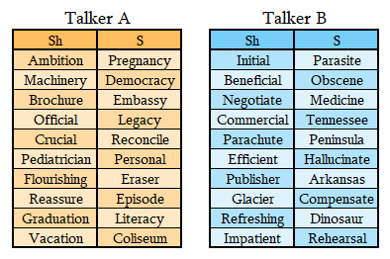
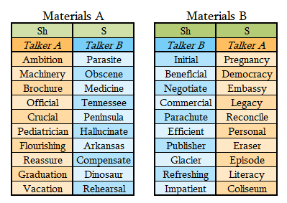
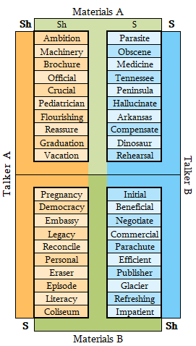
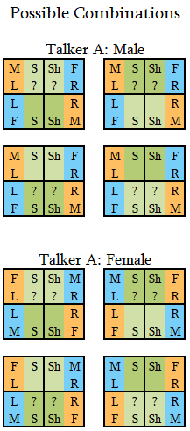
Figure 1
Figure 2
Figure 3a
Figure 1: The lists of s and ʃ words that will be produced in Talker A’s voice (left) and Talker B’s voice (right).
Figure 3b
Figure 2: How Talker words are paired into Critical Items and grouped into Materials A (left) and Materials B (right) to assign an ambiguous sound to half the Critical Items.
Figure 3a: A visual illustrating how the Critical Words spoken by Talker A and Talker B are divided into Materials A and Materials B. In this experiment, the words in Materials A are produced with an ambiguous sound and the words in Materials B are produced with an unambiguous sound. During the Critical Trials, each Talker is always heard in the same ear (e.g., Talker A in the Left Ear and Talker B in the Right Ear, as Shown above).
Figure 3b: Potential Configurations of factors. The “??” symbols represent which materials are assigned the ambiguous sound.

